Slide 1







Slide 2


PlantUML in Action
000
Opening and Introduction
Yasen – Enterprise Architecture
YouTube: @yasenzhao

Slide 3

PlantUML in Action
001
PlantUML Quick Starts
Utilizing a simple and intuitive language, users can effortlessly draft various types of diagrams.
Yasen – Enterprise Architecture
YouTube: @yasenzhao

Slide 4


PlantUML in Action
002
1. Sequence Diagram
1.1 Basic Examples
Yasen – Enterprise Architecture
YouTube: @yasenzhao

Slide 5


PlantUML in Action
003
1. Sequence Diagram
1.2 Declaring Participant
1.3 Declaring Participant on Multiline
Yasen – Enterprise Architecture
YouTube: @yasenzhao

Slide 6




PlantUML in Action
004
1. Sequence Diagram
1.4 Use Non-Letters in Participants
1.5 Message to Self
1.6 Text Alignment
Yasen – Enterprise Architecture
YouTube: @yasenzhao

Slide 7



PlantUML in Action
005
1. Sequence Diagram
1.7 Change Arrow Style
1.8 Change Arrow Color
Yasen – Enterprise Architecture
YouTube: @yasenzhao

Slide 8


PlantUML in Action
006
1. Sequence Diagram
1.9 Message Sequence Numbering
Yasen – Enterprise Architecture
YouTube: @yasenzhao

Slide 9


PlantUML in Action
007
1. Sequence Diagram
1.10 Page Title, Header and Footer
Yasen – Enterprise Architecture
YouTube: @yasenzhao

Slide 10

PlantUML in Action
008
1. Sequence Diagram
1.11 Splitting Diagrams
Yasen – Enterprise Architecture
YouTube: @yasenzhao

Slide 11


PlantUML in Action
009
1. Sequence Diagram
1.12 Grouping Message
Yasen – Enterprise Architecture
YouTube: @yasenzhao

Slide 12


PlantUML in Action
010
1. Sequence Diagram
1.13 Secondary Group Label
Yasen – Enterprise Architecture
YouTube: @yasenzhao

Slide 13


PlantUML in Action
011
1. Sequence Diagram
1.14 Notes on Messages
Yasen – Enterprise Architecture
YouTube: @yasenzhao

Slide 14


PlantUML in Action
012
1. Sequence Diagram
1.15 Some Other Notes
Yasen – Enterprise Architecture
YouTube: @yasenzhao

Slide 15


PlantUML in Action
013
1. Sequence Diagram
1.16 Changing Notes Shape
Yasen – Enterprise Architecture
YouTube: @yasenzhao

Slide 16


PlantUML in Action
014
1. Sequence Diagram
1.17 Note over all Participants
Yasen – Enterprise Architecture
YouTube: @yasenzhao

Slide 17



PlantUML in Action
015
1. Sequence Diagram
1.18 Several Notes aligned at the Same Level
Yasen – Enterprise Architecture
YouTube: @yasenzhao

Slide 18


PlantUML in Action
016
1. Sequence Diagram
1.19 Creole and HTML
Yasen – Enterprise Architecture
YouTube: @yasenzhao

Slide 19



PlantUML in Action
017
1. Sequence Diagram
1.20 Divider or Separator 1.21 Reference
Yasen – Enterprise Architecture
YouTube: @yasenzhao

Slide 20

PlantUML in Action
018
1. Sequence Diagram
1.22 Delay 1.23 Text Wrapping 1.24 Space
Yasen – Enterprise Architecture
YouTube: @yasenzhao

Slide 21



PlantUML in Action
019
1. Sequence Diagram
1.25 Lifeline Activation and Destruction
1.26 Return
Yasen – Enterprise Architecture
YouTube: @yasenzhao

Slide 22


PlantUML in Action
020
1. Sequence Diagram
1.27 Participant Creation
Yasen – Enterprise Architecture
YouTube: @yasenzhao

Slide 23



PlantUML in Action
021
1. Sequence Diagram
1.28 Shortcut Syntax
Yasen – Enterprise Architecture
YouTube: @yasenzhao

Slide 24



PlantUML in Action
022
1. Sequence Diagram
1.29 Incoming and Outgoing Messages
Yasen – Enterprise Architecture
YouTube: @yasenzhao

Slide 25


PlantUML in Action
023
1. Sequence Diagram
1.30 Short Arrows
Yasen – Enterprise Architecture
YouTube: @yasenzhao

Slide 26


PlantUML in Action
024
1. Sequence Diagram
1.31 Anchors and Duration
Yasen – Enterprise Architecture
YouTube: @yasenzhao

Slide 27


PlantUML in Action
025
1. Sequence Diagram
1.32 Stereotypes and Spots
Yasen – Enterprise Architecture
YouTube: @yasenzhao

Slide 28

PlantUML in Action
026
1. Sequence Diagram
1.33 More Information on Titles
Yasen – Enterprise Architecture
YouTube: @yasenzhao

Slide 29



PlantUML in Action
027
1. Sequence Diagram
1.34 Participants Encompass
1.35 Removing Foot Boxes
Yasen – Enterprise Architecture
YouTube: @yasenzhao

Slide 30



PlantUML in Action
028
1. Sequence Diagram
1.36 Skinparam
Yasen – Enterprise Architecture
YouTube: @yasenzhao

Slide 31


PlantUML in Action
029
1. Sequence Diagram
1.37 Changing Padding
Yasen – Enterprise Architecture
YouTube: @yasenzhao

Slide 32


PlantUML in Action
030
1. Sequence Diagram
1.38 Appendix: Arrow Types
Yasen – Enterprise Architecture
YouTube: @yasenzhao

Slide 33

PlantUML in Action
031
1. Sequence Diagram
1.39 Specific SkinParameter
Yasen – Enterprise Architecture
YouTube: @yasenzhao

Slide 34



PlantUML in Action
032
1. Sequence Diagram
1.40 Hide Unlinked Participant
Yasen – Enterprise Architecture
YouTube: @yasenzhao

Slide 35


PlantUML in Action
033
1. Sequence Diagram
1.41 Color a Group Message
Yasen – Enterprise Architecture
YouTube: @yasenzhao

Slide 36



PlantUML in Action
034
1. Sequence Diagram
1.42 Mainframe 1.43 Slanted or Odd Arrows
Yasen – Enterprise Architecture
YouTube: @yasenzhao

Slide 37



PlantUML in Action
035
2. Use Case Diagram
2.1 Use Cases 2.2 Actors
Yasen – Enterprise Architecture
YouTube: @yasenzhao

Slide 38


Slide 39


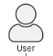

PlantUML in Action
036
2. Use Case Diagram
2.3 Change Actor Style
Yasen – Enterprise Architecture
YouTube: @yasenzhao

Slide 40


PlantUML in Action
037
2. Use Case Diagram
2.4 Usecases Description
Yasen – Enterprise Architecture
YouTube: @yasenzhao

Slide 41


PlantUML in Action
038
2. Use Case Diagram
2.5 Use Package
Yasen – Enterprise Architecture
YouTube: @yasenzhao

Slide 42


PlantUML in Action
039
2. Use Case Diagram
2.6 Basic Example for Use Case
Yasen – Enterprise Architecture
YouTube: @yasenzhao

Slide 43


PlantUML in Action
040
2. Use Case Diagram
2.7 Extension
Yasen – Enterprise Architecture
YouTube: @yasenzhao

Slide 44


PlantUML in Action
041
2. Use Case Diagram
2.8 Using notes in Use Case
Yasen – Enterprise Architecture
YouTube: @yasenzhao

Slide 45


PlantUML in Action
042
2. Use Case Diagram
2.9 Stereotypes
Yasen – Enterprise Architecture
YouTube: @yasenzhao

Slide 46


PlantUML in Action
043
2. Use Case Diagram
2.10 Changing Arrow Direction
Yasen – Enterprise Architecture
YouTube: @yasenzhao

Slide 47

PlantUML in Action
044
2. Use Case Diagram
2.11 Spitting Diagrams 2.12 Diagram Direction
Yasen – Enterprise Architecture
YouTube: @yasenzhao

Slide 48


PlantUML in Action
045
2. Use Case Diagram
2.13 Skinparam
Yasen – Enterprise Architecture
YouTube: @yasenzhao

Slide 49


PlantUML in Action
046
2. Use Case Diagram
2.14 Complete Example
Yasen – Enterprise Architecture
YouTube: @yasenzhao

Slide 50



PlantUML in Action
047
2. Use Case Diagram
2.15 Business Use Case
Yasen – Enterprise Architecture
YouTube: @yasenzhao

Slide 51


PlantUML in Action
048
2. Use Case Diagram
2.16 Change Arrow Color and Style (Inline)
Yasen – Enterprise Architecture
YouTube: @yasenzhao

Slide 52


PlantUML in Action
049
2. Use Case Diagram
2.17 Change Element Color and Style (Inline)
Yasen – Enterprise Architecture
YouTube: @yasenzhao

Slide 53


PlantUML in Action
050
2. Use Case Diagram
2.18 Display JSON Data on Use Case Diagram
Yasen – Enterprise Architecture
YouTube: @yasenzhao

Slide 54


PlantUML in Action
051
3. Class Diagram
3.01 Declaring Element
Yasen – Enterprise Architecture
YouTube: @yasenzhao

Slide 55


PlantUML in Action
052
3. Class Diagram
3.02 Relations between Classes
Yasen – Enterprise Architecture
YouTube: @yasenzhao

Slide 56


PlantUML in Action
053
3. Class Diagram
3.03 Lebel on Relations
Yasen – Enterprise Architecture
YouTube: @yasenzhao

Slide 57


PlantUML in Action
054
3. Class Diagram
3.04 Using Non-Letters in Element Names and Relation Labels
Yasen – Enterprise Architecture
YouTube: @yasenzhao

Slide 58


PlantUML in Action
055
3. Class Diagram
3.05 Adding Properties and Methods
Yasen – Enterprise Architecture
YouTube: @yasenzhao

Slide 59

PlantUML in Action
056
3. Class Diagram
A Real Example: Customer Shopping
https://landing.moqups.com/img/content/diagrams/uml-diagrams/uml-class-diagram/uml-class-1600.png
Yasen – Enterprise Architecture
YouTube: @yasenzhao

Slide 60


PlantUML in Action
057
3. Class Diagram
3.06 Defining Visibility
Yasen – Enterprise Architecture
YouTube: @yasenzhao

Slide 61


PlantUML in Action
058
3. Class Diagram
3.07 Abstract and Static Method
Yasen – Enterprise Architecture
YouTube: @yasenzhao

Slide 62


PlantUML in Action
059
3. Class Diagram
3.08 Advanced Class Body
Yasen – Enterprise Architecture
YouTube: @yasenzhao

Slide 63


PlantUML in Action
060
3. Class Diagram
3.09 Notes and Stereotypes
Yasen – Enterprise Architecture
YouTube: @yasenzhao

Slide 64


PlantUML in Action
061
3. Class Diagram
3.10 More on Notes
Yasen – Enterprise Architecture
YouTube: @yasenzhao

Slide 65


PlantUML in Action
062
3. Class Diagram
3.11 Note on Field or Method
Yasen – Enterprise Architecture
YouTube: @yasenzhao

Slide 66


PlantUML in Action
063
3. Class Diagram
3.12 Note on Links
Yasen – Enterprise Architecture
YouTube: @yasenzhao

Slide 67


PlantUML in Action
064
3. Class Diagram
3.13 Abstract Class and Interface
Yasen – Enterprise Architecture
YouTube: @yasenzhao

Slide 68

PlantUML in Action
065
3. Class Diagram
3.14 Hide Attributes, Methods…
Yasen – Enterprise Architecture
YouTube: @yasenzhao

Slide 69

PlantUML in Action
066
3. Class Diagram
3.15 Hide Classes & 3.16 Remove Classes
Yasen – Enterprise Architecture
YouTube: @yasenzhao

Slide 70


PlantUML in Action
067
3. Class Diagram
3.17 Hide, Remove or Restore Tagged Element or Wildcard
Yasen – Enterprise Architecture
YouTube: @yasenzhao

Slide 71

PlantUML in Action
068
3. Class Diagram
3.18 Hide or Remove Unlinked Class
Yasen – Enterprise Architecture
YouTube: @yasenzhao

Slide 72


PlantUML in Action
069
3. Class Diagram
3.19 Use Generics
Yasen – Enterprise Architecture
YouTube: @yasenzhao

Slide 73

PlantUML in Action
070
3. Class Diagram
3.20 Specific Spot
Yasen – Enterprise Architecture
YouTube: @yasenzhao

Slide 74


PlantUML in Action
071
3. Class Diagram
3.21 Packages
Yasen – Enterprise Architecture
YouTube: @yasenzhao

Slide 75


PlantUML in Action
072
3. Class Diagram
3.22 Packages Style 3.23 Namespaces
Yasen – Enterprise Architecture
YouTube: @yasenzhao

Slide 76


PlantUML in Action
073
3. Class Diagram
3.24 Automatic Package Creation
Yasen – Enterprise Architecture
YouTube: @yasenzhao

Slide 77


PlantUML in Action
074
3. Class Diagram
3.25 Lollipop Interface
Yasen – Enterprise Architecture
YouTube: @yasenzhao

Slide 78


PlantUML in Action
075
3. Class Diagram
3.26 Changing Arrows Orientation
Yasen – Enterprise Architecture
YouTube: @yasenzhao

Slide 79


PlantUML in Action
076
3. Class Diagram
3.27 Association Classes
Yasen – Enterprise Architecture
YouTube: @yasenzhao

Slide 80


PlantUML in Action
077
3. Class Diagram
3.28 Association on Same Class
Yasen – Enterprise Architecture
YouTube: @yasenzhao

Slide 81


PlantUML in Action
078
3. Class Diagram
3.29 Skinparam
Yasen – Enterprise Architecture
YouTube: @yasenzhao

Slide 82


PlantUML in Action
079
3. Class Diagram
3.30 Skinned Stereotypes
Yasen – Enterprise Architecture
YouTube: @yasenzhao

Slide 83


PlantUML in Action
080
3. Class Diagram
3.31 Color Gradient
Yasen – Enterprise Architecture
YouTube: @yasenzhao

Slide 84


PlantUML in Action
081
3. Class Diagram
3.32 Help on Layout
Yasen – Enterprise Architecture
YouTube: @yasenzhao

Slide 85


PlantUML in Action
082
3. Class Diagram
3.33 Splitting Large Files
Yasen – Enterprise Architecture
YouTube: @yasenzhao

Slide 86
PlantUML in Action
083
3. Class Diagram
3.33 Splitting Large Files (fix)
Yasen – Enterprise Architecture
YouTube: @yasenzhao

Slide 87


PlantUML in Action
084
3. Class Diagram
3.34 Extends and Implements
Yasen – Enterprise Architecture
YouTube: @yasenzhao

Slide 88


PlantUML in Action
085
3. Class Diagram
3.35 Bracketed Relations Style
Yasen – Enterprise Architecture
YouTube: @yasenzhao

Slide 89


PlantUML in Action
086
3. Class Diagram
3.36 Change Relation Color and Style
Yasen – Enterprise Architecture
YouTube: @yasenzhao

Slide 90


PlantUML in Action
087
3. Class Diagram
3.37 Change Class Color and Style
Yasen – Enterprise Architecture
YouTube: @yasenzhao

Slide 91


PlantUML in Action
088
3. Class Diagram
3.38 Arrow From/To Class Members
Yasen – Enterprise Architecture
YouTube: @yasenzhao

Slide 92


PlantUML in Action
089
3. Class Diagram
3.39 Grouping Inheritance Arrow Heads
Yasen – Enterprise Architecture
YouTube: @yasenzhao

Slide 93


PlantUML in Action
090
3. Class Diagram
3.40 Display JSON Data on Class or Object Diagram
Yasen – Enterprise Architecture
YouTube: @yasenzhao

Slide 94


PlantUML in Action
091
3. Class Diagram
3.41 Packages and Namespaces Enhancement
Yasen – Enterprise Architecture
YouTube: @yasenzhao

Slide 95



PlantUML in Action
092
4. Object Diagram
4.1 Definition of Objects 4.2 Relations between Object
Yasen – Enterprise Architecture
YouTube: @yasenzhao

Slide 96



PlantUML in Action
093
4. Object Diagram
4.3 Associations Objects 4.4 Adding Fields
Yasen – Enterprise Architecture
YouTube: @yasenzhao

Slide 97

PlantUML in Action
094
4. Object Diagram
4.5 Common Features with Class Diagram
Yasen – Enterprise Architecture
YouTube: @yasenzhao

Slide 98


PlantUML in Action
095
4. Object Diagram
4.6 Map Table or Associative Array
Yasen – Enterprise Architecture
YouTube: @yasenzhao

Slide 99


PlantUML in Action
096
4. Object Diagram
4.7 PERT with Map
Yasen – Enterprise Architecture
YouTube: @yasenzhao

Slide 100


PlantUML in Action
097
4. Object Diagram
4.8 Display JSON Data on Class/Object Diagram
Yasen – Enterprise Architecture
YouTube: @yasenzhao

Slide 101



PlantUML in Action
098
5. Activity Diagram (legacy)
5.1 Simple Action 5.2 Label on Arrows
Yasen – Enterprise Architecture
YouTube: @yasenzhao

Slide 102


PlantUML in Action
099
5. Activity Diagram (legacy)
5.3 Changing Arrow Direction
Yasen – Enterprise Architecture
YouTube: @yasenzhao

Slide 103


PlantUML in Action
100
5. Activity Diagram (legacy)
5.4 Branches
Yasen – Enterprise Architecture
YouTube: @yasenzhao

Slide 104


PlantUML in Action
101
5. Activity Diagram (legacy)
5.5 More on Branches
Yasen – Enterprise Architecture
YouTube: @yasenzhao

Slide 105


PlantUML in Action
102
5. Activity Diagram (legacy)
5.6 Synchronization
Yasen – Enterprise Architecture
YouTube: @yasenzhao

Slide 106


PlantUML in Action
103
5. Activity Diagram (legacy)
Practice: Brainstorming Process
Yasen – Enterprise Architecture
YouTube: @yasenzhao

Slide 107
a1
a2
a3
b1
b2
a4
a5
b3
a6
b4

Slide 108


PlantUML in Action
104
5. Activity Diagram (legacy)
5.7 Long Action Description
Yasen – Enterprise Architecture
YouTube: @yasenzhao

Slide 109



PlantUML in Action
105
5. Activity Diagram (legacy)
5.8 Notes in Activity Diagram
Yasen – Enterprise Architecture
YouTube: @yasenzhao

Slide 110


PlantUML in Action
106
5. Activity Diagram (legacy)
5.9 Partition
Yasen – Enterprise Architecture
YouTube: @yasenzhao

Slide 111



PlantUML in Action
107
5. Activity Diagram (legacy)
5.10 Skinparam 5.11 Octagon
Yasen – Enterprise Architecture
YouTube: @yasenzhao

Slide 112


PlantUML in Action
108
5. Activity Diagram (legacy)
5.12 Complete Example
Yasen – Enterprise Architecture
YouTube: @yasenzhao

Slide 113




PlantUML in Action
109
6. Activity Diagram (New Syntax)
6.01 Simple Action 6.02 Start/Stop/End
Yasen – Enterprise Architecture
YouTube: @yasenzhao

Slide 114


PlantUML in Action
110
6. Activity Diagram (New Syntax)
6.03 Conditional
Yasen – Enterprise Architecture
YouTube: @yasenzhao

Slide 115


PlantUML in Action
111
6. Activity Diagram (New Syntax)
6.04 Switch and Case [switch, case, endswitch]
Yasen – Enterprise Architecture
YouTube: @yasenzhao

Slide 116



PlantUML in Action
112
6. Activity Diagram (New Syntax)
6.05 Conditional with stop on an action
Yasen – Enterprise Architecture
YouTube: @yasenzhao

Slide 117



PlantUML in Action
113
6. Activity Diagram (New Syntax)
6.06 Repeat Loop
Yasen – Enterprise Architecture
YouTube: @yasenzhao

Slide 118


PlantUML in Action
114
6. Activity Diagram (New Syntax)
6.07 Break on a repeat loop [break]
Yasen – Enterprise Architecture
YouTube: @yasenzhao

Slide 119


PlantUML in Action
115
6. Activity Diagram (New Syntax)
6.08 Goto and Label Processing [label, goto]
Yasen – Enterprise Architecture
YouTube: @yasenzhao

Slide 120


PlantUML in Action
116
6. Activity Diagram (New Syntax)
6.09 While loop
Yasen – Enterprise Architecture
YouTube: @yasenzhao

Slide 121

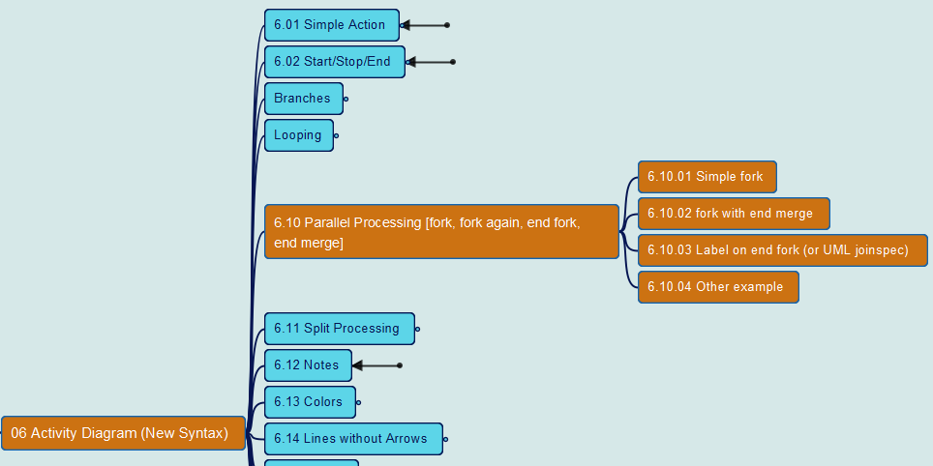
PlantUML in Action
117
6. Activity Diagram (New Syntax)
6.10 Parallel Processing
Yasen – Enterprise Architecture
YouTube: @yasenzhao

Slide 122


PlantUML in Action
118
6. Activity Diagram (New Syntax)
6.11 Split Processing
Yasen – Enterprise Architecture
YouTube: @yasenzhao

Slide 123


PlantUML in Action
119
6. Activity Diagram (New Syntax)
6.12 Notes
Yasen – Enterprise Architecture
YouTube: @yasenzhao

Slide 124


PlantUML in Action
120
6. Activity Diagram (New Syntax)
6.13 Colors
Yasen – Enterprise Architecture
YouTube: @yasenzhao

Slide 125


PlantUML in Action
121
6. Activity Diagram (New Syntax)
6.14 Lines without Arrows
Yasen – Enterprise Architecture
YouTube: @yasenzhao

Slide 126


PlantUML in Action
122
6. Activity Diagram (New Syntax)
6.15 Arrows
Yasen – Enterprise Architecture
YouTube: @yasenzhao

Slide 127
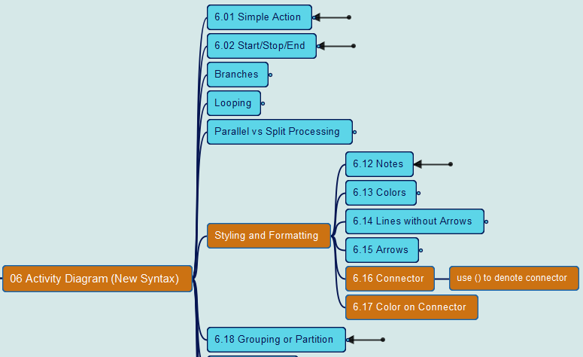
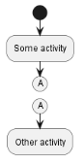
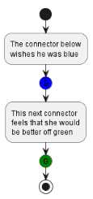
PlantUML in Action
123
6. Activity Diagram (New Syntax)
6.16 Connector 6.17 Color on Connector
Yasen – Enterprise Architecture
YouTube: @yasenzhao

Slide 128
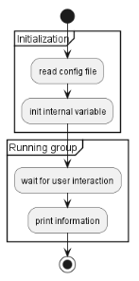
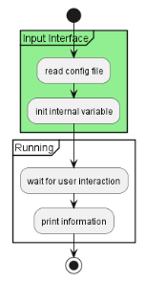
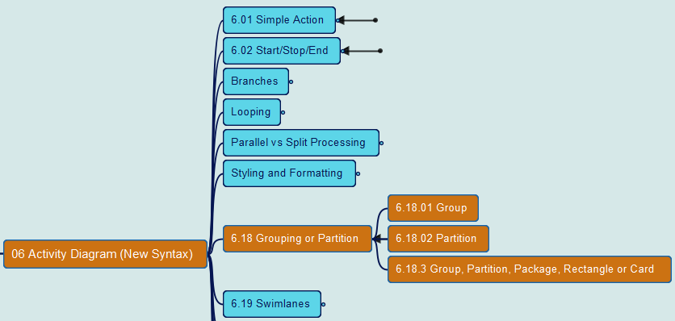
PlantUML in Action
124
6. Activity Diagram (New Syntax)
6.18 Grouping or Partition
Yasen – Enterprise Architecture
YouTube: @yasenzhao

Slide 129
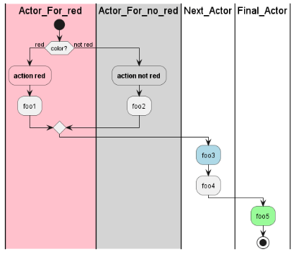
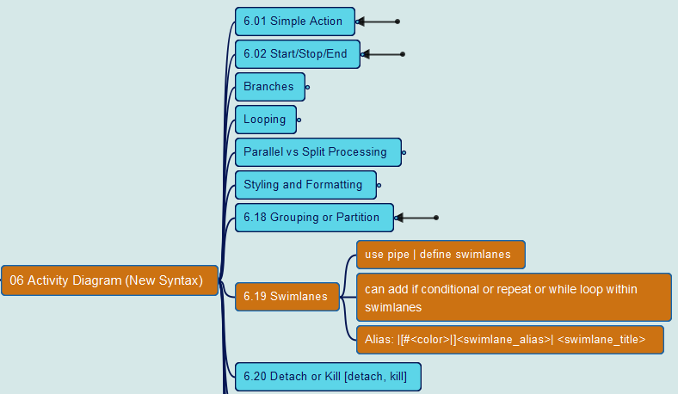
PlantUML in Action
125
6. Activity Diagram (New Syntax)
6.19 Swimlanes
Yasen – Enterprise Architecture
YouTube: @yasenzhao

Slide 130
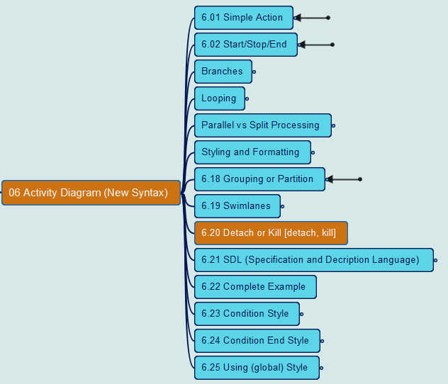
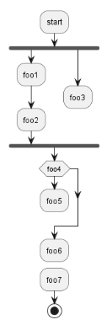
PlantUML in Action
126
6. Activity Diagram (New Syntax)
6.20 Detach or Kill
Yasen – Enterprise Architecture
YouTube: @yasenzhao

Slide 131
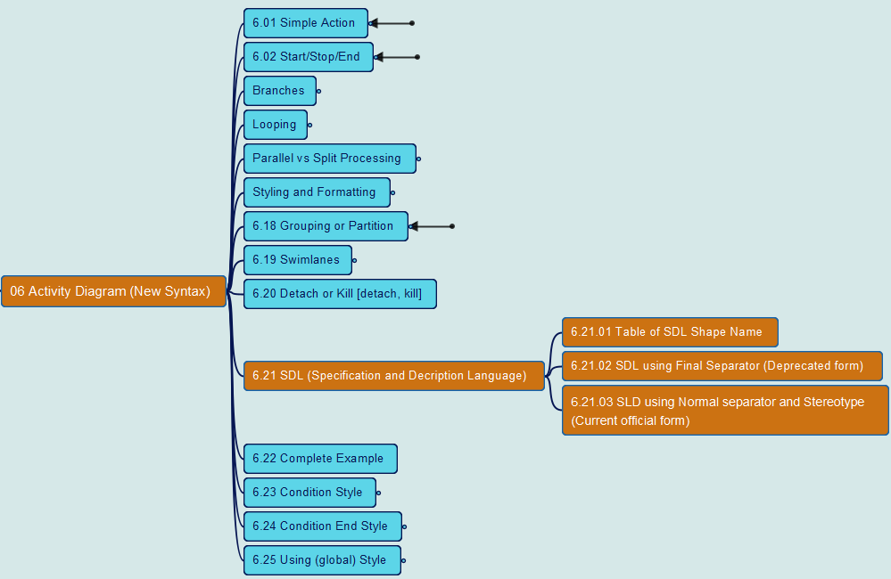
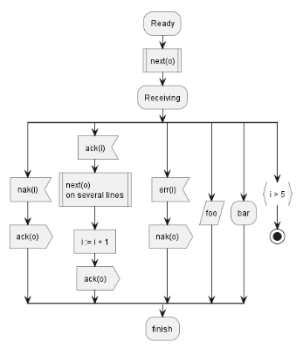
PlantUML in Action
127
6. Activity Diagram (New Syntax)
6.21 SDL (Specification and Description Language)
Yasen – Enterprise Architecture
YouTube: @yasenzhao

Slide 132
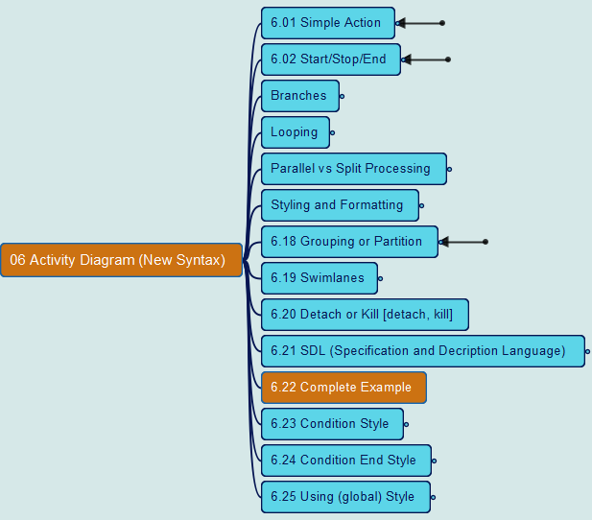
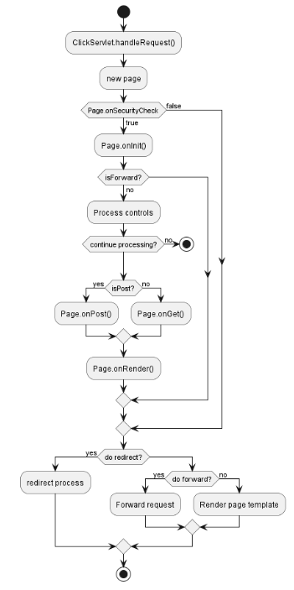
PlantUML in Action
128
6. Activity Diagram (New Syntax)
6.22 Complete Example
Yasen – Enterprise Architecture
YouTube: @yasenzhao

Slide 133
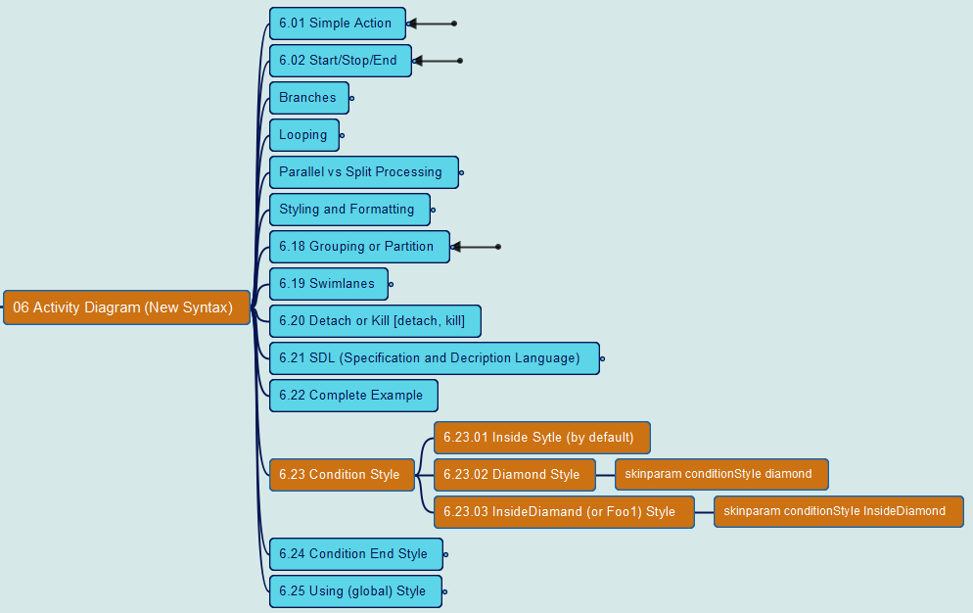
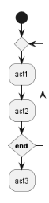
PlantUML in Action
129
6. Activity Diagram (New Syntax)
6.23 Condition Style
Yasen – Enterprise Architecture
YouTube: @yasenzhao

Slide 134
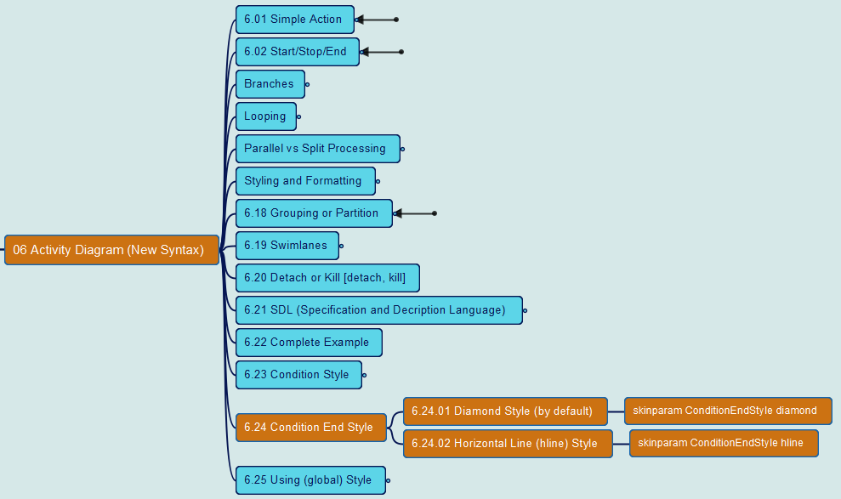
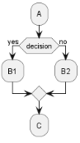
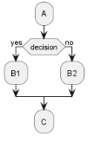
PlantUML in Action
130
6. Activity Diagram (New Syntax)
6.24 Condition End Style
Yasen – Enterprise Architecture
YouTube: @yasenzhao

Slide 135
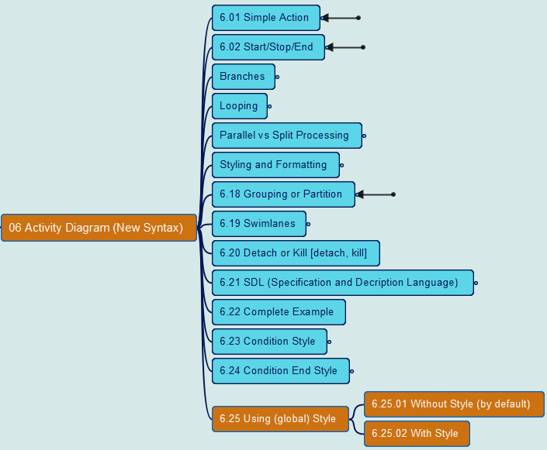
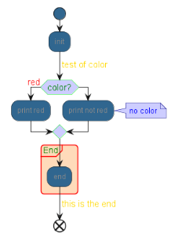
PlantUML in Action
131
6. Activity Diagram (New Syntax)
6.25 Using (global) Style
Yasen – Enterprise Architecture
YouTube: @yasenzhao

Slide 136
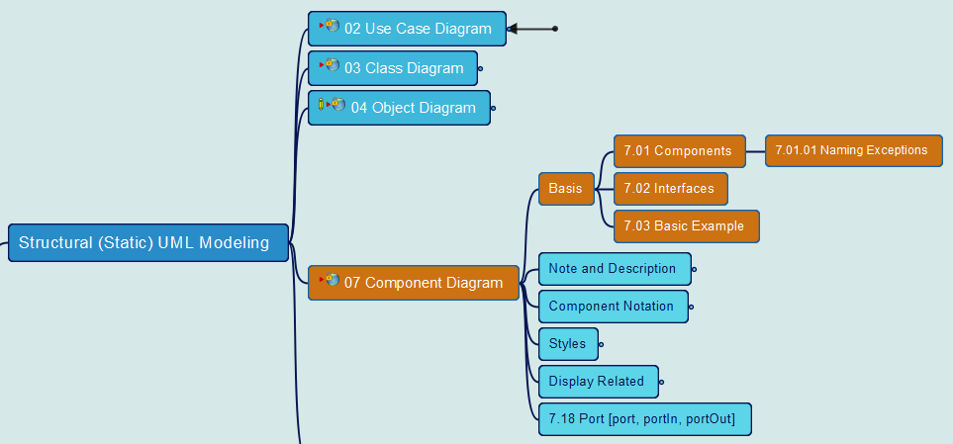
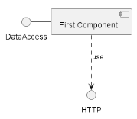
PlantUML in Action
132
7. Component Diagram
7.1 Components 7.2 Interfaces 7.3 Sample
Yasen – Enterprise Architecture
YouTube: @yasenzhao

Slide 137
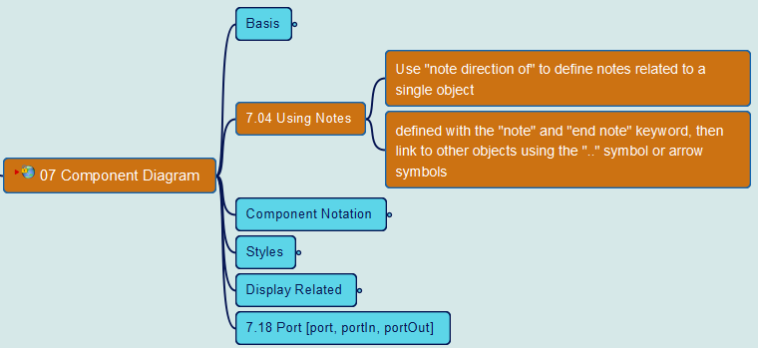
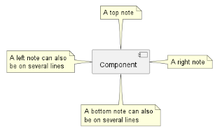
PlantUML in Action
133
7. Component Diagram
7.4 Using Notes
Yasen – Enterprise Architecture
YouTube: @yasenzhao

Slide 138
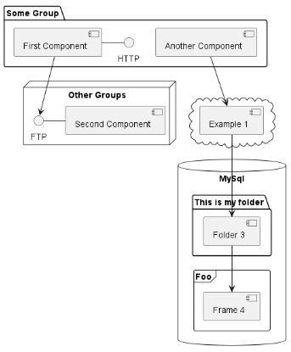
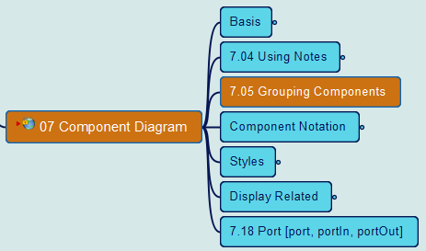
PlantUML in Action
134
7. Component Diagram
7.05 Grouping Components
Yasen – Enterprise Architecture
YouTube: @yasenzhao

Slide 139
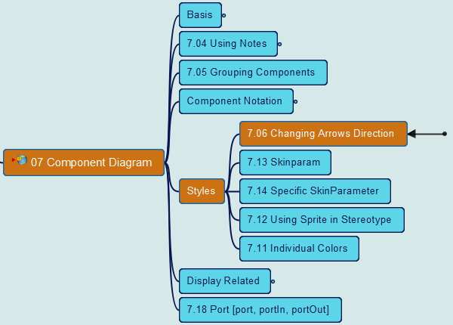
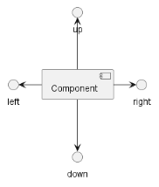
PlantUML in Action
135
7. Component Diagram
7.06 Changing Arrow Direction
Yasen – Enterprise Architecture
YouTube: @yasenzhao

Slide 140
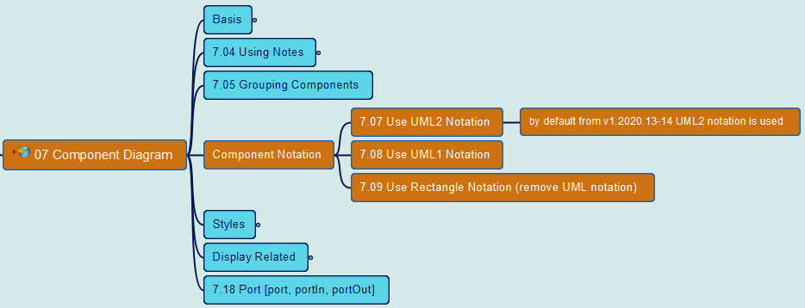
PlantUML in Action
136
7. Component Diagram
7.07/08 Use UML1/2 Notation 7.09 Use Rectangle Notation
Yasen – Enterprise Architecture
YouTube: @yasenzhao

Slide 141
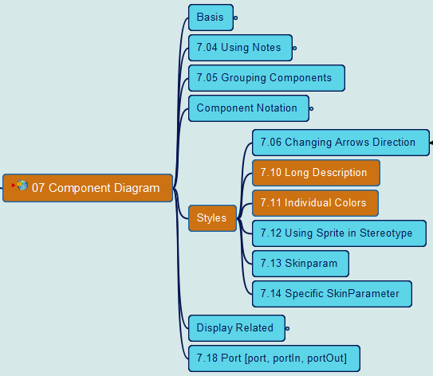
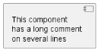
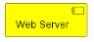
PlantUML in Action
137
7. Component Diagram
7.10 Long Description 7.11 Individual Colors
Yasen – Enterprise Architecture
YouTube: @yasenzhao

Slide 142
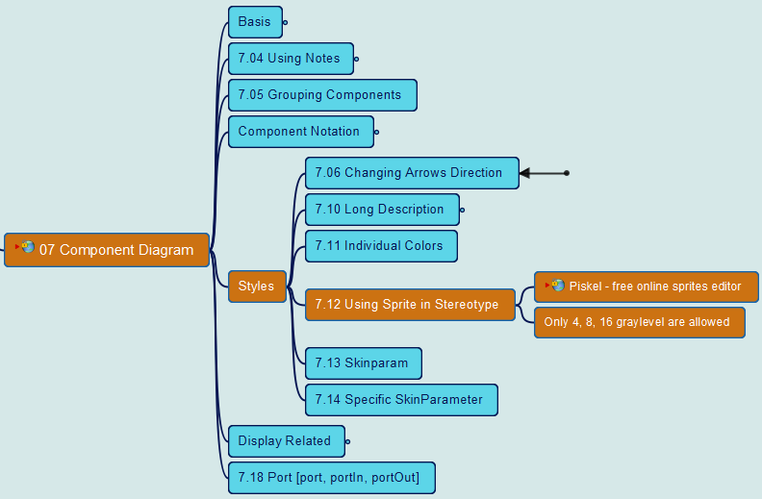
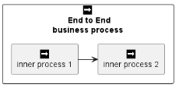
PlantUML in Action
138
7. Component Diagram
7.12 Using Sprite in Stereotype
Yasen – Enterprise Architecture
YouTube: @yasenzhao

Slide 143
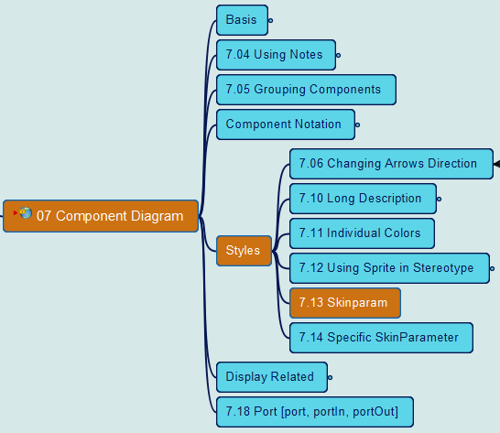
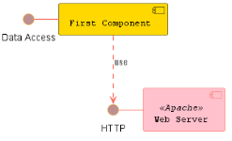
PlantUML in Action
139
7. Component Diagram
7.13 Skinparam
Yasen – Enterprise Architecture
YouTube: @yasenzhao

Slide 144
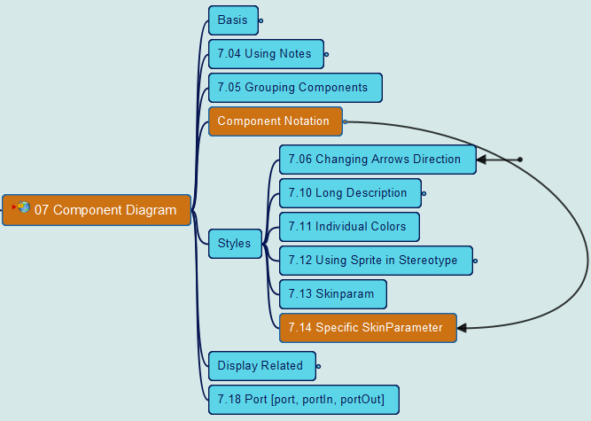
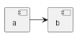
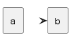
PlantUML in Action
140
7. Component Diagram
7.14 Specific SkinParameter
Yasen – Enterprise Architecture
YouTube: @yasenzhao

Slide 145
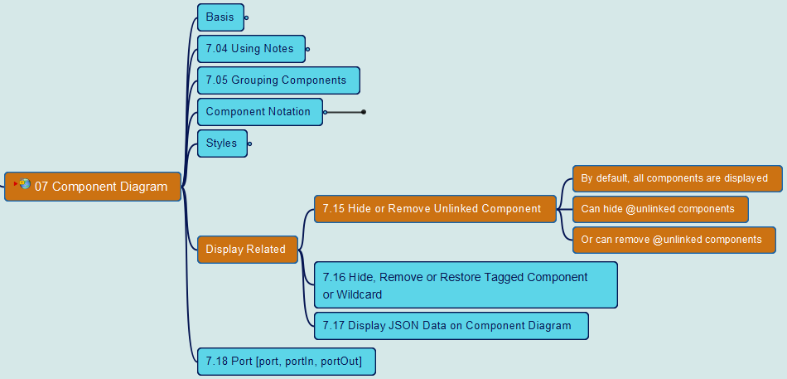
PlantUML in Action
141
7. Component Diagram
7.15 Hide or Remove unlinked component
Yasen – Enterprise Architecture
YouTube: @yasenzhao

Slide 146
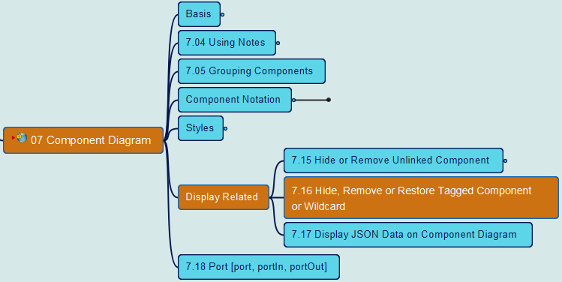
PlantUML in Action
142
7. Component Diagram
7.16 Hide, Remove or Restore tagged component or wildcard
Yasen – Enterprise Architecture
YouTube: @yasenzhao

Slide 147
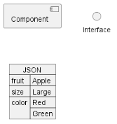
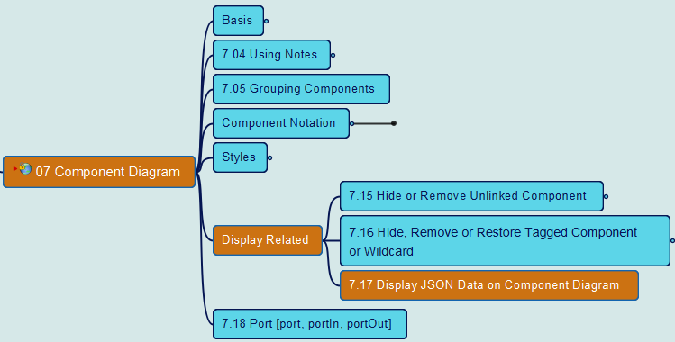
PlantUML in Action
143
7. Component Diagram
7.17 Display JSON Data on Component Diagram
Yasen – Enterprise Architecture
YouTube: @yasenzhao

Slide 148
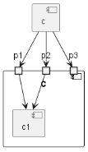
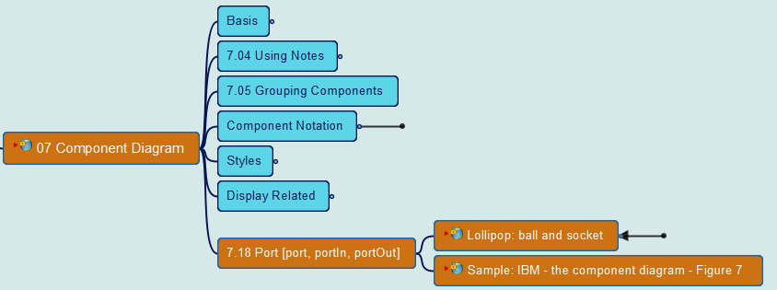
PlantUML in Action
144
7. Component Diagram
7.18-1 Port [port, portIn, portOut]
Yasen – Enterprise Architecture
YouTube: @yasenzhao

Slide 149
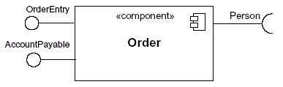
PlantUML in Action
145
7. Component Diagram
7.18-2 Lollipop Notation
Yasen – Enterprise Architecture
YouTube: @yasenzhao

Slide 150
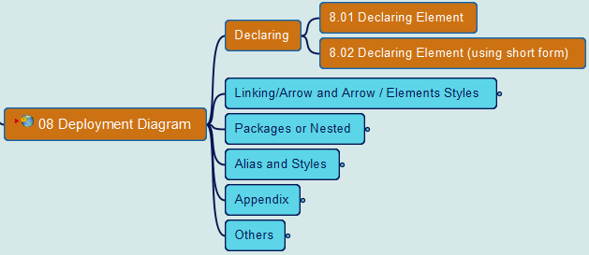

PlantUML in Action
146
8. Deployment Diagram
8.1 & 8.2 Declaring Elements
Yasen – Enterprise Architecture
YouTube: @yasenzhao

Slide 151


PlantUML in Action
147
8. Deployment Diagram
8.3 Linking or Arrow
Yasen – Enterprise Architecture
YouTube: @yasenzhao

Slide 152


PlantUML in Action
148
8. Deployment Diagram
8.4 Bracketed Arrow Style
Yasen – Enterprise Architecture
YouTube: @yasenzhao

Slide 153


PlantUML in Action
149
8. Deployment Diagram
8.5 Change Arrow Color and Style (inline)
Yasen – Enterprise Architecture
YouTube: @yasenzhao

Slide 154


PlantUML in Action
150
8. Deployment Diagram
8.6 Change Element Color and Style (inline)
Yasen – Enterprise Architecture
YouTube: @yasenzhao

Slide 155


PlantUML in Action
151
8. Deployment Diagram
8.7 Nestable Elements 8.8 Packages and Nested Elements
Yasen – Enterprise Architecture
YouTube: @yasenzhao

Slide 156

PlantUML in Action
152
8. Deployment Diagram
8.9 Alias in Deployment Diagram
Yasen – Enterprise Architecture
YouTube: @yasenzhao

Slide 157


PlantUML in Action
153
8. Deployment Diagram
8.10 Round Corner 8.11 Specific SkinParameter
Yasen – Enterprise Architecture
YouTube: @yasenzhao

Slide 158


PlantUML in Action
154
8. Deployment Diagram
8.17 Display JSON Data 8.18 Mixed Deployment
Yasen – Enterprise Architecture
YouTube: @yasenzhao

Slide 159


PlantUML in Action
155
8. Deployment Diagram
8.19 Port [port, portIn, portOut]
Yasen – Enterprise Architecture
YouTube: @yasenzhao

Slide 160


PlantUML in Action
156
9. State Diagram
9.01 Simple State 9.02 Change state rendering
Yasen – Enterprise Architecture
YouTube: @yasenzhao

Slide 161
PlantUML in Action
(source) | State Diagram | Activity Diagram
Purpose | Model reactive systems | Model non-reactive systems
Focus | Internal state of an object or system | Sequence of activities involved in a process or workflow
Elements | States, transitions, events | Activities, actions, transitions
Complexity | More complex | Less complex
Use cases | Embedded systems, control systems, real-time systems | Business processes, workflows, software processes
Yasen – Enterprise Architecture
YouTube: @yasenzhao

Slide 162


PlantUML in Action
157
9. State Diagram
9.03 Composite state
Yasen – Enterprise Architecture
YouTube: @yasenzhao

Slide 163


PlantUML in Action
158
9. State Diagram
9.04 Long name in State Diagram
Yasen – Enterprise Architecture
YouTube: @yasenzhao

Slide 164


PlantUML in Action
159
9. State Diagram
9.05 History [ [H], [H*] ]
Yasen – Enterprise Architecture
YouTube: @yasenzhao

Slide 165


PlantUML in Action
160
9. State Diagram
9.06 Fork [fork, join]
Yasen – Enterprise Architecture
YouTube: @yasenzhao

Slide 166


PlantUML in Action
161
9. State Diagram
9.07 Concurrent State [--, ||]
Yasen – Enterprise Architecture
YouTube: @yasenzhao

Slide 167


PlantUML in Action
162
9. State Diagram
9.08 Conditional [choice]
Yasen – Enterprise Architecture
YouTube: @yasenzhao

Slide 168


PlantUML in Action
163
9. State Diagram
9.09 Stereotypes full example [start, choice, fork, join, end]
Yasen – Enterprise Architecture
YouTube: @yasenzhao

Slide 169


PlantUML in Action
164
9. State Diagram
9.10 Point [entryPoint, exitPoint]
Yasen – Enterprise Architecture
YouTube: @yasenzhao

Slide 170


PlantUML in Action
165
9. State Diagram
9.11 Pin [inputPin, outputPin]
Yasen – Enterprise Architecture
YouTube: @yasenzhao

Slide 171


PlantUML in Action
166
9. State Diagram
9.12 Expansion [expansionInput, expansionOutput]
Yasen – Enterprise Architecture
YouTube: @yasenzhao

Slide 172


PlantUML in Action
167
9. State Diagram
9.13 Arrow direction & 9.14 Change line color and style
Yasen – Enterprise Architecture
YouTube: @yasenzhao

Slide 173


PlantUML in Action
168
9. State Diagram
9.15 Note & 9.16 Note on link & 9.17 More in notes
Yasen – Enterprise Architecture
YouTube: @yasenzhao

Slide 174


PlantUML in Action
169
9. State Diagram
9.18 Inline color
Yasen – Enterprise Architecture
YouTube: @yasenzhao

Slide 175


PlantUML in Action
170
9. State Diagram
9.19 Skinparam
Yasen – Enterprise Architecture
YouTube: @yasenzhao

Slide 176


PlantUML in Action
171
9. State Diagram
9.20 Changing style
Yasen – Enterprise Architecture
YouTube: @yasenzhao

Slide 177


PlantUML in Action
172
9. State Diagram
9.21 Change state color and style (inline style)
Yasen – Enterprise Architecture
YouTube: @yasenzhao

Slide 178


PlantUML in Action
173
9. State Diagram
9.22 Alias & 9.23 Display JSON Data
Yasen – Enterprise Architecture
YouTube: @yasenzhao

Slide 179


PlantUML in Action
174
10. Timing Diagram
10.01 Declaring Element or Participant
Yasen – Enterprise Architecture
YouTube: @yasenzhao

Slide 180


PlantUML in Action
175
10. Timing Diagram
10.02 Binary and Clock
Yasen – Enterprise Architecture
YouTube: @yasenzhao

Slide 181


PlantUML in Action
176
10. Timing Diagram
10.03 Adding Message
Yasen – Enterprise Architecture
YouTube: @yasenzhao

Slide 182


PlantUML in Action
177
10. Timing Diagram
10.04 Relative time
Yasen – Enterprise Architecture
YouTube: @yasenzhao

Slide 183


PlantUML in Action
178
10. Timing Diagram
10.05 Anchor Points
Yasen – Enterprise Architecture
YouTube: @yasenzhao

Slide 184


PlantUML in Action
179
10. Timing Diagram
10.06 Participant oriented
Yasen – Enterprise Architecture
YouTube: @yasenzhao

Slide 185


PlantUML in Action
180
10. Timing Diagram
10.07 Setting scale
Yasen – Enterprise Architecture
YouTube: @yasenzhao

Slide 186


PlantUML in Action
181
10. Timing Diagram
10.08 Initial state
Yasen – Enterprise Architecture
YouTube: @yasenzhao

Slide 187


PlantUML in Action
182
10. Timing Diagram
10.09 Intricated state
Yasen – Enterprise Architecture
YouTube: @yasenzhao

Slide 188


PlantUML in Action
183
10. Timing Diagram
10.10 Hidden state
Yasen – Enterprise Architecture
YouTube: @yasenzhao

Slide 189


PlantUML in Action
184
10. Timing Diagram
10.11 Hide time axis
Yasen – Enterprise Architecture
YouTube: @yasenzhao

Slide 190


PlantUML in Action
185
10. Timing Diagram
10.12 Using Time and Date
Yasen – Enterprise Architecture
YouTube: @yasenzhao

Slide 191


PlantUML in Action
186
10. Timing Diagram
10.13 Adding constraint
Yasen – Enterprise Architecture
YouTube: @yasenzhao

Slide 192


PlantUML in Action
187
10. Timing Diagram
10.14 Highlighted period
Yasen – Enterprise Architecture
YouTube: @yasenzhao

Slide 193


PlantUML in Action
188
10. Timing Diagram
10.15 Using notes
Yasen – Enterprise Architecture
YouTube: @yasenzhao

Slide 194


PlantUML in Action
189
10. Timing Diagram
10.16 Adding texts
Yasen – Enterprise Architecture
YouTube: @yasenzhao

Slide 195


PlantUML in Action
190
10. Timing Diagram
10.17 Complete example
Yasen – Enterprise Architecture
YouTube: @yasenzhao

Slide 196


PlantUML in Action
191
10. Timing Diagram
10.18 Digital Example
Yasen – Enterprise Architecture
YouTube: @yasenzhao

Slide 197


PlantUML in Action
192
10. Timing Diagram
10.19 Adding color
Yasen – Enterprise Architecture
YouTube: @yasenzhao

Slide 198


PlantUML in Action
193
10. Timing Diagram
10.20 Using (global) style
Yasen – Enterprise Architecture
YouTube: @yasenzhao

Slide 199


PlantUML in Action
194
10. Timing Diagram
10.21 Applying Colors to specific lines
Yasen – Enterprise Architecture
YouTube: @yasenzhao

Slide 200


PlantUML in Action
195
10. Timing Diagram
10.22 Compact mode
Yasen – Enterprise Architecture
YouTube: @yasenzhao

Slide 201

PlantUML in Action
196
Opening to the Non-UML diagrams
Yasen – Enterprise Architecture
YouTube: @yasenzhao

Slide 202


PlantUML in Action
197
11. Display JSON Data
11.1 Complex Example
Yasen – Enterprise Architecture
YouTube: @yasenzhao

Slide 203


PlantUML in Action
198
11. Display JSON Data
11.2 Highlight Parts
Yasen – Enterprise Architecture
YouTube: @yasenzhao

Slide 204


PlantUML in Action
199
11. Display JSON Data
11.3 Using Different Styles for Highlight
Yasen – Enterprise Architecture
YouTube: @yasenzhao

Slide 205


PlantUML in Action
200
11. Display JSON Data
11.4 JSON Basic Elements
Yasen – Enterprise Architecture
YouTube: @yasenzhao

Slide 206


PlantUML in Action
201
11. Display JSON Data
11.5 JSON Array or Table
Yasen – Enterprise Architecture
YouTube: @yasenzhao

Slide 207


PlantUML in Action
202
11. Display JSON Data
11.6 JSON Numbers
Yasen – Enterprise Architecture
YouTube: @yasenzhao

Slide 208


PlantUML in Action
203
11. Display JSON Data
11.7 JSON Strings
Yasen – Enterprise Architecture
YouTube: @yasenzhao

Slide 209


PlantUML in Action
204
11. Display JSON Data
11.8 Minimal JSON Examples & 11.9 Empty Table or List
Yasen – Enterprise Architecture
YouTube: @yasenzhao

Slide 210


PlantUML in Action
205
11. Display JSON Data
11.10 Using (Global) Style
Yasen – Enterprise Architecture
YouTube: @yasenzhao

Slide 211


PlantUML in Action
206
11. Display JSON Data
11.11 Display JSON Data on Class or Object Diagram
Yasen – Enterprise Architecture
YouTube: @yasenzhao

Slide 212


PlantUML in Action
207
11. Display JSON Data
11.12 Display JSON Data on Deployment Diagram
Yasen – Enterprise Architecture
YouTube: @yasenzhao

Slide 213


PlantUML in Action
208
11. Display JSON Data
11.13 Display JSON Data on State Diagram
Yasen – Enterprise Architecture
YouTube: @yasenzhao

Slide 214


PlantUML in Action
209
12. Display YAML Data
12.1 Complex Example
Yasen – Enterprise Architecture
YouTube: @yasenzhao

Slide 215


PlantUML in Action
210
12. Display YAML Data
12.2 Specific Key (with symbols or Unicode)
Yasen – Enterprise Architecture
YouTube: @yasenzhao

Slide 216


PlantUML in Action
211
12. Display YAML Data
12.3 Highlight Parts
Yasen – Enterprise Architecture
YouTube: @yasenzhao

Slide 217


PlantUML in Action
212
12. Display YAML Data
12.4 Using Different Styles for Highlight
Yasen – Enterprise Architecture
YouTube: @yasenzhao

Slide 218


PlantUML in Action
213
12. Display YAML Data
12.5 Using (Global) Style
Yasen – Enterprise Architecture
YouTube: @yasenzhao

Slide 219



PlantUML in Action
214
13 Network Diagram (nwdiag)
13.1 Simple Diagram
Yasen – Enterprise Architecture
YouTube: @yasenzhao
Thanks Takeshi Komiya

Slide 220


PlantUML in Action
215
13 Network Diagram (nwdiag)
13.2 Define Multiple Addresses
Yasen – Enterprise Architecture
YouTube: @yasenzhao
Thanks Takeshi Komiya

Slide 221


PlantUML in Action
216
13 Network Diagram (nwdiag)
13.3 Grouping Nodes
Yasen – Enterprise Architecture
YouTube: @yasenzhao
Thanks Takeshi Komiya

Slide 222



PlantUML in Action
217
13 Network Diagram (nwdiag)
13.4 Extended Syntax (for network and group)
Yasen – Enterprise Architecture
YouTube: @yasenzhao
Thanks Takeshi Komiya

Slide 223


PlantUML in Action
218
13 Network Diagram (nwdiag)
13.5 Using Sprites
Yasen – Enterprise Architecture
YouTube: @yasenzhao
Thanks Takeshi Komiya

Slide 224


PlantUML in Action
219
13 Network Diagram (nwdiag)
13.6 Using Open-Iconic
Yasen – Enterprise Architecture
YouTube: @yasenzhao
Thanks Takeshi Komiya

Slide 225


PlantUML in Action
220
13 Network Diagram (nwdiag)
13.7 Same Nodes on More Than Two Networks
Yasen – Enterprise Architecture
YouTube: @yasenzhao
Thanks Takeshi Komiya

Slide 226


PlantUML in Action
221
13 Network Diagram (nwdiag)
13.8 Peer Networks
Yasen – Enterprise Architecture
YouTube: @yasenzhao
Thanks Takeshi Komiya

Slide 227


PlantUML in Action
222
13 Network Diagram (nwdiag)
13.9 Peer Networks and Group
Yasen – Enterprise Architecture
YouTube: @yasenzhao
Thanks Takeshi Komiya

Slide 228


PlantUML in Action
223
13 Network Diagram (nwdiag)
13.10 Add Title, Caption, Header, Footer or Legend
Yasen – Enterprise Architecture
YouTube: @yasenzhao
Thanks Takeshi Komiya

Slide 229


PlantUML in Action
224
13 Network Diagram (nwdiag)
13.11 With or Without Shadow
Yasen – Enterprise Architecture
YouTube: @yasenzhao
Thanks Takeshi Komiya

Slide 230


PlantUML in Action
225
13 Network Diagram (nwdiag)
13.12 Change Width of the Networks
Yasen – Enterprise Architecture
YouTube: @yasenzhao
Thanks Takeshi Komiya

Slide 231


PlantUML in Action
226
13 Network Diagram (nwdiag)
13.13 Other Internal Networks
Yasen – Enterprise Architecture
YouTube: @yasenzhao
Thanks Takeshi Komiya

Slide 232


PlantUML in Action
227
13 Network Diagram (nwdiag)
13.14 Using (global) Style
Yasen – Enterprise Architecture
YouTube: @yasenzhao
Thanks Takeshi Komiya

Slide 233


PlantUML in Action
228
14 Salt (Wireframe)
14.01 Basic Widgets (including Wireframe Basics)
Yasen – Enterprise Architecture
YouTube: @yasenzhao

Slide 234


PlantUML in Action
229
14 Salt (Wireframe)
14.02 Text Area
Yasen – Enterprise Architecture
YouTube: @yasenzhao

Slide 235

PlantUML in Action
230
14 Salt (Wireframe)
14.03 Open, Close Droplist
Yasen – Enterprise Architecture
YouTube: @yasenzhao

Slide 236



PlantUML in Action
231
14 Salt (Wireframe)
14.04 Using Grid [ | and #, !, -, +], 14.05 Group Box [^]
Yasen – Enterprise Architecture
YouTube: @yasenzhao

Slide 237



PlantUML in Action
232
14 Salt (Wireframe)
14.06 Using Separator & 14.07 Tree Widget
Yasen – Enterprise Architecture
YouTube: @yasenzhao

Slide 238


PlantUML in Action
233
14 Salt (Wireframe)
14.08 Tree Table [T]
Yasen – Enterprise Architecture
YouTube: @yasenzhao

Slide 239


PlantUML in Action
234
14 Salt (Wireframe)
14.09 Enclosing Brackets [{, }]
Yasen – Enterprise Architecture
YouTube: @yasenzhao

Slide 240


PlantUML in Action
235
14 Salt (Wireframe)
14.10 Adding Tabs [ / ]
Yasen – Enterprise Architecture
YouTube: @yasenzhao

Slide 241


PlantUML in Action
236
14 Salt (Wireframe)
14.11 Using Menu [ * ]
Yasen – Enterprise Architecture
YouTube: @yasenzhao

Slide 242


PlantUML in Action
237
14 Salt (Wireframe)
14.12 Advanced Table
Yasen – Enterprise Architecture
YouTube: @yasenzhao

Slide 243


PlantUML in Action
238
14 Salt (Wireframe)
14.13 Scroll Bars [S, SI, S-]
Yasen – Enterprise Architecture
YouTube: @yasenzhao

Slide 244


PlantUML in Action
239
14 Salt (Wireframe)
14.14 Colors
Yasen – Enterprise Architecture
YouTube: @yasenzhao

Slide 245


PlantUML in Action
240
14 Salt (Wireframe)
14.15 Creole on Salt (part 1)
Yasen – Enterprise Architecture
YouTube: @yasenzhao

Slide 246
PlantUML in Action
241
14 Salt (Wireframe)
14.15 Creole on Salt (part 2)
Yasen – Enterprise Architecture
YouTube: @yasenzhao

Slide 247


PlantUML in Action
242
14 Salt (Wireframe)
14.16 Pseudo Sprite [ <<, >> ]
Yasen – Enterprise Architecture
YouTube: @yasenzhao

Slide 248


PlantUML in Action
243
14 Salt (Wireframe)
14.17 OpenIconic
Yasen – Enterprise Architecture
YouTube: @yasenzhao

Slide 249


PlantUML in Action
244
14 Salt (Wireframe)
14.18 Add Title, Header, Footer, Captain or Legend
Yasen – Enterprise Architecture
YouTube: @yasenzhao

Slide 250



PlantUML in Action
245
14 Salt (Wireframe)
14.19 Zoom, DPI
Yasen – Enterprise Architecture
YouTube: @yasenzhao

Slide 251


PlantUML in Action
246
14 Salt (Wireframe)
14.20 Include Salt “on activity diagram”
Yasen – Enterprise Architecture
YouTube: @yasenzhao

Slide 252


PlantUML in Action
247
14 Salt (Wireframe)
14.21 Include Salt “on while condition of activity diagram”
Yasen – Enterprise Architecture
YouTube: @yasenzhao

Slide 253


PlantUML in Action
248
14 Salt (Wireframe)
14.22 Include Salt “on repeat while condition of activity diagram”
Yasen – Enterprise Architecture
YouTube: @yasenzhao

Slide 254



PlantUML in Action
249
14 Salt (Wireframe)
14.23 Skinparam (Skin Parameter)
Yasen – Enterprise Architecture
YouTube: @yasenzhao

Slide 255

PlantUML in Action
250
14 Salt (Wireframe)
14.24 Style
Yasen – Enterprise Architecture
YouTube: @yasenzhao

Slide 256



PlantUML in Action
251
15 ArchiMate Diagram
15.01 ArchiMate Keyword
Yasen – Enterprise Architecture
YouTube: @yasenzhao

Slide 257


PlantUML in Action
252
15 ArchiMate Diagram
15.02 Defining Junctions
Yasen – Enterprise Architecture
YouTube: @yasenzhao

Slide 258


PlantUML in Action
253
15 ArchiMate Diagram
15.03 Example 1 (Method 1)
Yasen – Enterprise Architecture
YouTube: @yasenzhao

Slide 259
PlantUML in Action
254
15 ArchiMate Diagram
15.03 Example 1 (Method 2)
Yasen – Enterprise Architecture
YouTube: @yasenzhao

Slide 260


PlantUML in Action
255
15 ArchiMate Diagram
15.04 Example 2 & 15.05 List Possible Sprites
Yasen – Enterprise Architecture
YouTube: @yasenzhao

Slide 261


PlantUML in Action
256
15 ArchiMate Diagram
15.06 ArchiMate Macros
Yasen – Enterprise Architecture
YouTube: @yasenzhao

Slide 262


PlantUML in Action
257
16 GANTT Diagram
16.00 Contents Introduction and Navigation
Yasen – Enterprise Architecture
YouTube: @yasenzhao

Slide 263


PlantUML in Action
258
16 GANTT Diagram
16.01 Declaring Tasks
Yasen – Enterprise Architecture
YouTube: @yasenzhao

Slide 264


PlantUML in Action
259
16 GANTT Diagram
16.02 One-Line Declaration (with “and” conjunction)
Yasen – Enterprise Architecture
YouTube: @yasenzhao

Slide 265


PlantUML in Action
260
16 GANTT Diagram
16.03 Adding Constraints
Yasen – Enterprise Architecture
YouTube: @yasenzhao

Slide 266


PlantUML in Action
261
16 GANTT Diagram
16.04 Short Names
Yasen – Enterprise Architecture
YouTube: @yasenzhao

Slide 267


PlantUML in Action
262
16 GANTT Diagram
16.05 Customize Colors
Yasen – Enterprise Architecture
YouTube: @yasenzhao
GitHub: https://github.com/yasenstar/PlantUML_in_Action
Gitee: https://gitee.com/yasenstar/PlantUML_in_Action

Slide 268


PlantUML in Action
263
16 GANTT Diagram
16.06 Completion Status
Yasen – Enterprise Architecture
YouTube: @yasenzhao

Slide 269


PlantUML in Action
264
16 GANTT Diagram
16.07 Milestone
Yasen – Enterprise Architecture
YouTube: @yasenzhao

Slide 270



PlantUML in Action
265
16 GANTT Diagram
16.08 Hyperlinks & 16.09 Calendar
Yasen – Enterprise Architecture
YouTube: @yasenzhao

Slide 271


PlantUML in Action
266
16 GANTT Diagram
16.10 Coloring Days
Yasen – Enterprise Architecture
YouTube: @yasenzhao

Slide 272


PlantUML in Action
267
16 GANTT Diagram
16.11 Changing Scale (1)
Yasen – Enterprise Architecture
YouTube: @yasenzhao

Slide 273

PlantUML in Action
268
16 GANTT Diagram
16.11 Changing Scale (2)
Yasen – Enterprise Architecture
YouTube: @yasenzhao

Slide 274


PlantUML in Action
269
16 GANTT Diagram
16.12 Zoom (Example for all Scale)
Yasen – Enterprise Architecture
YouTube: @yasenzhao

Slide 275


PlantUML in Action
270
16 GANTT Diagram
16.13 Weekscale with Weeknumbers or Calendar Date
Yasen – Enterprise Architecture
YouTube: @yasenzhao

Slide 276


PlantUML in Action
271
16 GANTT Diagram
16.14 Close Day
Yasen – Enterprise Architecture
YouTube: @yasenzhao

Slide 277


PlantUML in Action
272
16 GANTT Diagram
16.15 Definition of a Week Depending of Closed Days
Yasen – Enterprise Architecture
YouTube: @yasenzhao

Slide 278


PlantUML in Action
273
16 GANTT Diagram
16.16 Working Days
Yasen – Enterprise Architecture
YouTube: @yasenzhao

Slide 279


PlantUML in Action
274
16 GANTT Diagram
16.17 Simplified Task Succession
Yasen – Enterprise Architecture
YouTube: @yasenzhao

Slide 280


PlantUML in Action
275
16 GANTT Diagram
16.18 Working with Resources
Yasen – Enterprise Architecture
YouTube: @yasenzhao

Slide 281



PlantUML in Action
276
16 GANTT Diagram
16.19 Hide Resources
Yasen – Enterprise Architecture
YouTube: @yasenzhao

Slide 282



PlantUML in Action
277
16 GANTT Diagram
16.20 Horizontal Separator & 16.21 Vertical Separator
Yasen – Enterprise Architecture
YouTube: @yasenzhao

